Slide 1


Module 1. Lesson 2.
Review. Lists
Link to guidelines

Slide 2

Module 1. Lesson 2. Review. Lists
Discussion:
The A’s for All
private school

Slide 3
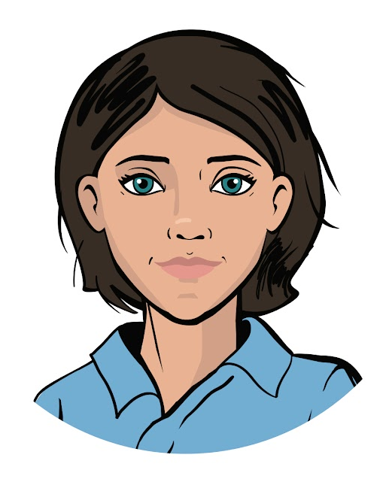

Great news!
The director of the A’s for All private school liked the automatic knowledge testing system so much that he ordered another project from ProTeam.
Now you have to develop an electronic
data archive about students and teachers to store the following:
information on performance;
list of subjects and lesson schedules;
information about school trips;
personal data
Discussing
work tasks
Ready? Let's start with a typical task!
Emily,
project manager

Slide 4
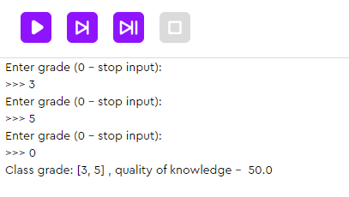
Test results analysis
The task. Write a program to upload an archive of grades for the final test (how many there are is not known in advance) and determine the quality of knowledge.
The program should display all the grades received and the quality of knowledge. (The maximum grade is 5, the minimum grade is 0.)
Num. of 5s + num. of 4s
Quality of knowledge =
• 100
Num. of people tested
Discussing
work tasks
Input unknown number of grades in advance
(for example, until input 0).
Output result set.
Output quality of knowledge.

Slide 5
Test results analysis
The task. Write a program to upload an archive of grades for the final test (how many there are is not known in advance) and determine the quality of knowledge.
The program should display all the grades received and the quality of knowledge. (The maximum grade is 5, the minimum grade is 0.)
Num. of 5s + num. of 4s
Quality of knowledge =
• 100
Num. of people tested
Discussing
work tasks
Input unknown number of grades in advance
(for example, until input 0).
Output result set.
Output quality of knowledge.
What algorithm will the program run on?
How will it work for one grade?

Slide 6
Let’s look at how to determine the quality of one grade:
Num. of fives = 0
Num. of fours = 0
Input grade
Yes
Is it a five?
No
Increase the num. of fives by 1
What is the code for this algorithm?
Discussing
work tasks
Yes
Is it a four?
No
Increase the num. of fours by 1
Calculate the quality of knowledge
Output grade and quality

Slide 7
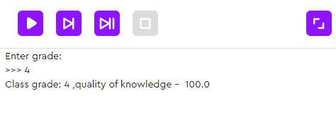
Let’s look at how to determine the quality of one grade:
amount_five = 0
amount_four = 0
mark = int(input('Enter grade:'))
if mark == 5:
amount_five += 1
if mark == 4:
amount_four += 1
knowledge = (amount_five + amount_four)/1*100
print('Class grade:', mark, ',quality of knowledge - ', knowledge)
Num. of fives = 0
Num. of fours = 0
Input grade
Yes
Is it a five?
No
Increase the num. of fives by 1
Discussing
work tasks
Yes
Is it a four?
No
Increase the num. of fours by 1
Calculate the quality of knowledge
Output grade and quality
a + = 1 is equivalent to a = a + 1

Slide 8
Let’s look at how to determine the quality of one grade:
Num. of fives = 0
Num. of fours = 0
Input grade
Yes
Is it a five?
No
Increase the num. of fives by 1
How do we request an unknown number of grades and save them all in the program?
Discussing
work tasks
Yes
Is it a four?
No
Increase the num. of fours by 1
Calculate the quality of knowledge
How do we change the flowchart?
Output grade and quality

Slide 9
Determining the quality of multiple grades:
amount_four = 0
amount_five = 0
mark = -1
List for
storing grades.
marks = list()
No
mark != 0?
Yes
Enter until 0.
Input: mark
Yes
No
mark == 5?
Discussing
work tasks
amount_five += 1
Yes
No
mark == 4?
amount_four += 1
Each grade is added to the set.
Add mark to marks
When the input is complete, delete the grade zero.
Delete 0 from marks

Slide 10
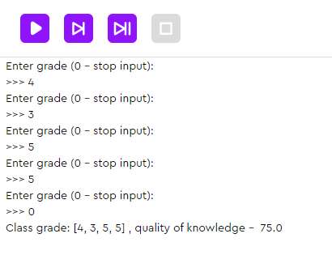
Determining the quality of multiple grades:
amount_five = 0
amount_four = 0
mark = -1
marks = list()
while mark != 0:
mark = int(input('Enter grade (0 - stop input):'))
if mark == 5:
amount_five += 1
if mark == 4:
amount_four += 1
marks.append(mark)
marks.remove(0)
knowledge = (amount_five + amount_four) / len(marks) * 100
print('Class grade:', marks, ', quality of knowledge - ', knowledge)
Discussing
work tasks

Slide 11
Determining the quality of multiple grades:
amount_five = 0
amount_four = 0
mark = -1
marks = list()
while mark != 0:
mark = int(input('Enter grade (0 - stop input):'))
if mark == 5:
amount_five += 1
if mark == 4:
amount_four += 1
marks.append(mark)
marks.remove(0)
knowledge = (amount_five + amount_four) / len(marks) * 100
print('Class grade:', marks, ', quality of knowledge - ', knowledge)
Discussing
work tasks
It is convenient to store archive data in a special structure –– lists.

Slide 12
The goal of the work day is
to program a school data archive
using lists and methods of working with them.
Today you will:
Discussing
work tasks
go through another stage of qualifications to rebuild your developer’s skills;
program an archive for storing and analyzing data;
study a basic Python data structure — lists.

Slide 13

Module 1. Lesson 2. Review. Lists
Qualifications

Slide 14

Show that you are ready for a brainstorming session!
Show how fast you can get your developer skills back.
Qualifications

Slide 15
Which types of loops do you know? What words are used to set them?
Qualifications

Slide 16
Which types of loops do you know? What words are used to set them?
the while loop
the for loop
Each of them is useful in certain situations.
Qualifications

Slide 17
The while loop:
repeat actions while the condition is true;
repeat actions and count the number of repetitions.
BASIC:
LOOP WITH A COUNTER:
i = 0
while
Expression is true
:
while
Expression is true
:
Qualifications
Perform action 1
Perform action 1
Perform action 2
Perform action 2
Perform action 3
i = i + 1

Slide 18
The for loop:
repeat actions x times;
bypass the ordered sequence.
REPEAT ACTIONS X TIMES:
Performing actions
for
For each integer i from m to n:
Perform action 1.
Perform action 2.
Qualifications
i in the range from m to n
:
Perform action 1
Perform action 2

Slide 19
The for loop:
repeat actions x times;
bypass the ordered sequence.
REPEAT ACTIONS X TIMES:
print('Odd number of students:')
for i in range(12):
For each integer i from 0 to 11:
If the number is odd,
Print it.
Qualifications
if i % 2 == 1:
print(i)
range(n)
–– return a sequence of numbers from 0 to n-1.
range(m, n)
–– return a sequence of numbers from m to n-1.

Slide 20
The for loop:
repeat actions x times;
bypass the ordered sequence.
BYPASS THE ORDERED SEQUENCE:
Performing actions
for
:
For each element of the sequence:
Perform action 1.
Perform action 2.
Qualifications
each element of the sequence
Perform action 1
Perform action 2

Slide 21
The for loop:
repeat actions x times;
bypass the ordered sequence.
BYPASS THE ORDERED SEQUENCE:
login = input('Create a login')
for symbol in login:
For each symbol in the string:
If the symbol is a dot,
print the message.
Qualifications
if symbol == '.':
print('Letters and numbers only')
login = 'sasha2007'
s | a | s | h | a | 2 | 0 | 0 | 7
0 | 1 | 2 | 3 | 4 | 5 | 6 | 7 | 8

Slide 22
What is a function?
How can you create your own function?
Qualifications

Slide 23
A function is an algorithm compiled in a programming language that has a unique name.
A function is defined using a def statement.
def ( , …):
Function name
parameter 1
parameter 1
Perform action 1
Qualifications
Perform action 2

Slide 24
What types of functions do you know?
How do we create a function that returns a value?
Qualifications

Slide 25
Types of functions:
functions that return a value (number, list);
functions that return nothing (None).
FUNCTION RETURNING A VALUE:
def ( , …):
Function name
parameter 1
parameter 1
Qualifications
Perform action 1
Perform action 2
return
Value

Slide 26
Types of functions:
functions that return a value (number, list);
functions that return nothing (None).
FUNCTION NOT RETURNING A VALUE:
def ( , …):
Function name
parameter 1
parameter 1
Qualifications
Perform action 1
Perform action 2

Slide 27

Qualifications confirmed!
Great, you are ready for brainstorming and completing your work tasks!
Qualifications

Slide 28

Module 1. Lesson 2. Review. Lists
Brainstorming:
The A’s for All
private school

Slide 29

Data archive for a private school
To fulfill the order, we’ll use the data structure - a list.
Each of you should know the following:
What is a list? What data can it store?
How do we work with list items?
There are a lot of methods for working with lists.
It's important to understand how they work
and have a description of them at hand.
Brainstorming

Slide 30
A list is a structure for the ordered storage of data of different types.
Example. List of long jump results.
results = [181, 176, 160, 178, 171, 179, 165]
List name
List items
Brainstorming
181 | 176 | 160 | 178 | 171 | 179 | 165
0 | 1 | 2 | 3 | 4 | 5 | 6
Numbers of list items

Slide 31
A list is a structure for the ordered storage of data of different types.
Example. List of long jump results.
results = [181, 176, 160, 178, 171, 179, 165]
print(‘Best result:’, results[0])
Best result: 181
Brainstorming
Getting a list item using its number (index)

Slide 32
To implement a project for programming a data archive, we need to be able to solve problems:
Data storage and printing in whole and in parts
Create list, get list item, print list
Adding new data and deleting unnecessary data
Adding and removing items, clearing the entire list
Brainstorming
Finding the data you want in a dataset
Searching for occurrences of an element in the list
Data processing for different purposes
Sorting list items, iterating over items in a loop,
determining the length of the list

Slide 33
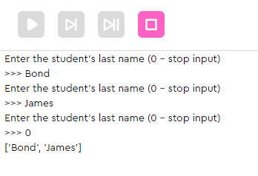
Planning work tasks
Task 1а. At the beginning of the school year, students can enroll in clubs. Write a program for regional studies enrollment. The program should do the following:
request the names of the students as input and add them to the group.
after input is complete, print the group list.
Example of such a program:
Brainstorming
What tools can help create the program?

Slide 34
Planning work tasks
Task 1а. At the beginning of the school year, students can enroll in clubs. Write a program for regional studies enrollment. The program should do the following:
request the names of the students as input and add them to the group.
after input is complete, print the group list.
We need these tools:
Function | Purpose
students = list() | Declaring an empty list
students.append(Smith) | Adding an item to the end of the list
print(students) | Printing the entire list
Brainstorming

Slide 35
Planning work tasks
Task 1а. At the beginning of the school year, students can enroll in clubs. Write a program for regional studies enrollment. The program should do the following:
request the names of the students as input and add them to the group.
after input is complete, print the group list.
students = list()
student = input(“Enter the student’s last name (0 - stop input)”)
while student != “0”:
students.append(student)
student = input(“Enter the student’s last name (0 - stop input)”)
print(students)
Brainstorming

Slide 36
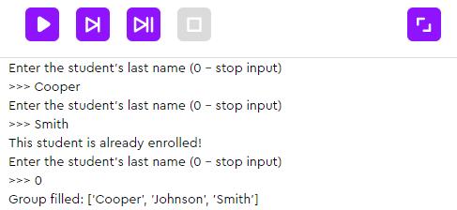
Planning work tasks
Task 1b. The teacher asked to modify the program.
The list should already contain the names of last year's students (Johnson, Smith).
Safeguard against inattention: if the name entered is already in the list, do not add it again.
After you finish entering names, sort them alphabetically.
Example of such a program:
Brainstorming
What tools can help modify the program?

Slide 37
Planning work tasks
Task 1b. The teacher asked to modify the program.
The list should already contain the names of last year's students (Johnson, Smith).
Safeguard against inattention: if the name entered is already in the list, do not add it again.
After you finish entering names, sort them alphabetically.
We need these tools:
Command | Purpose
students = [Johnson, ...] | Declaring a list of items
‘Johnson’ in students | Searching for an occurrence of an item in the list (returns True or False)
students.sort() | Sorting the list in lexicographical order (ascending numbers and letters of the alphabet)
Brainstorming

Slide 38
Planning work tasks
Task 1b. The teacher asked to modify the program.
The list should already contain the names of last year's students (Johnson, Smith).
Safeguard against inattention: if the name entered is already in the list, do not add it again.
After you finish entering names, sort them alphabetically.
students = ['Smith', 'Johnson']
student = input('Enter the student's last name (0 - stop input)')
while student != '0':
if student in students:
print('This student is already enrolled!')
else:
students.append(student)
student = input('Enter the student's last name (0 - stop input)')
students.sort()
print('Group filled:', students)
Brainstorming

Slide 39
Before proceeding to another task:
What will the previous program display if the user enters Freeman? Johnson?
The user entered these names: Pitt, Alba, Davidson, Smith. What will the program display?
How can we modify the program and limit the input capability to ten names?
Brainstorming

Slide 40
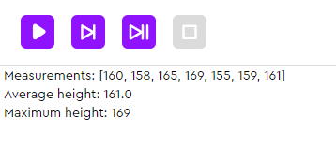
Planning work tasks
Task 2. Every six months, the nurse measures the students’ heights. The archive already contains the measurement results of 6A. We need to do the following:
calculate and display the average height;
determine the height of the tallest student.
Example of such a program:
Brainstorming
What tools can help us write the program?

Slide 41
Planning work tasks
Task 2. Every six months, the nurse measures the students’ heights. The archive already contains the measurement results of 6A. We need to do the following:
calculate and display the average height;
determine the height of the tallest student.
We need these tools:
Command | Purpose
for height in heights: Command1 Command2 | Sort through the items in the heights list. “For each item (height) in the list (heights) perform Command1, Command2”
len(heights) | Determining the length of the heights list
Brainstorming

Slide 42
Planning work tasks
Task 2. Every six months, the nurse measures the students’ heights. The archive already contains the measurement results of 6A. We need to do the following:
calculate and display the average height;
determine the height of the tallest student.
heights = [160, 158, 165, 169, 155, 159, 161]
average_height = 0
max_height = 0
for height in heights:
average_height += height
if max_height < height:
max_height = height
average_height = average_height / len(heights)
print('Measurements:', heights)
print('Average height:', average_height)
print('Maximum height:', max_height)
Brainstorming

Slide 43
Before proceeding to another task:
What will the program display if another dataset is loaded: [164, 160, 162]? What will the value of the variable max_height be at each step of the loop?
How will the results change if we apply the sort() method before starting to iterate over the items in the list in a loop?
How can we change the program so that it displays the minimum height instead of the maximum?
Brainstorming

Slide 44
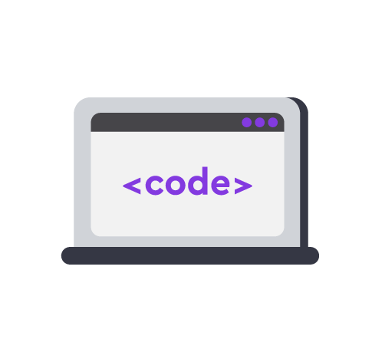
Module 1. Lesson 2. Review. Lists
A’s for All:
Data archive

Slide 45




Complete tasks on the platform
A’s for All: data archive
mars.alg.academy
A;s for All:
Data archive

Slide 46

Break

Slide 47
Module 1. Lesson 2. Review. Lists
Brainstorming:
The A’s for All
private school

Slide 48
Planning work tasks
The task. Write a program that requests the input of a random number of grades, stores them in an archive (as a list), and displays the number of students who received 5s.
Brainstorming
How do we write such a program?

Slide 49
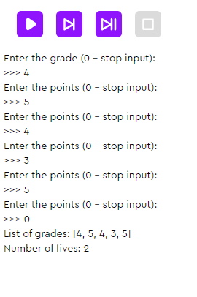
Planning work tasks
The task. Write a program that requests the input of a random number of grades, stores them in an archive (as a list), and displays the number of students who received 5s.
marks = list()
amount_five = 0
mark = int(input('Enter the grade (0 - stop input):'))
while mark != 0:
if mark == 5:
amount_five += 1
marks.append(mark)
mark = int(input('Enter the points (0 - stop input):'))
print('List of grades:', marks)
print('Number of fives:', amount_five)
Brainstorming

Slide 50
Planning work tasks
In fact, there is a method to simplify the solution of the problem.
It is often used when processing keyboard data input.
marks = list()
amount_five = 0
mark = int(input('Enter the grade (0 - stop input):'))
while mark != 0:
if mark == 5:
amount_five += 1
marks.append(mark)
mark = int(input('Enter the points (0 - stop input):'))
print('List of grades:', marks)
print('Number of fives:', amount_five)
Brainstorming

Slide 51
Planning work tasks
The task. Write a program that requests the input of a random number of grades, stores them in an archive (as a list), and displays the number of students who received 5s.
this is a method that splits the string into parts according to the specified separator. A list is made from the received parts.
marks_list = marks.split(‘ ’)
Brainstorming
Program | The program displays
marks = '4 5 3 2 3 5' marks = marks.split(' ') print(marks) | ['4', '5', '3', '2', '3', '5']

Slide 52
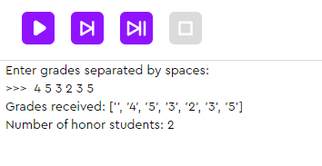
Planning work tasks
The task. Write a program that requests the input of a random number of grades, stores them in an archive (as a list), and displays the number of students who received 5s.
marks = list()
marks = marks.split(' ')
honours_student = 0
for mark in marks:
if mark == '5':
honours_student += 1
print('Получены оценки:', marks)
print('Количество отличников:', honours_student)
How will the program change?
Brainstorming

Slide 53
Planning work tasks
The task. Write a program that requests the input of a random number of grades, stores them in an archive (as a list), and displays the number of students who received 5s.
marks = input('Enter grades separated by spaces((The maximum grade is 5, the minimum grade is 0.)):')
marks = marks.split(' ')
honours_student = 0
for mark in marks:
if mark == '5':
honours_student += 1
print('Grades received:', marks)
print('Number of honor students:', honours_student)
Brainstorming

Slide 54
Strings and lists
You may have noticed that strings and lists have a lot in common.
Thanks to the Python interpreter, it has become possible to use the same operators to work with multiple data types.
Brainstorming

Slide 55
Strings and lists
Comparing different methods for working with strings and lists:
Command | Strings | Lists
marks1 + marks2 | Merging strings into one | Merging lists into one
marks * 3 | Repeat a string x times | Repeat items in a list x times
len(marks) | Calculating string length (number of symbols) | Calculating list length (number of items)
marks[i] | Getting a symbol using a number | Getting an item using a number
marks.find(‘5’) | Search for an occurrence of a substring (returns the input number) | -
‘5’ in marks | Search for an occurrence of a symbol in string | Search for an occurrence of an item in a list
Brainstorming

Slide 56
Strings and lists
Comparing different methods for working with strings and lists
Command | Strings |  | Lists
Merging | ‘5’ + ‘4’ | ‘54’ | [‘5’, ‘4’] + [‘5’] | [‘5’, ‘4’, ‘5’]
Repeat x times | ‘5’ * 3 | ‘555’ | [‘5’] * 3 | [‘5’, ‘5’, ‘5’]
Length | l = len(‘5’) | 1 | l = len([‘5’, ‘4’, ‘5’]) | 3
Get using a number | marks = ‘545’ r = marks[2] | ‘5’ | marks = [‘5’, ‘4’, ‘5’] r = marks[2] | ‘5’
Search for an occurrence | marks = ‘545’ r = marks.find(‘3’) | -1 | marks = [‘5’, ‘4’, ‘5’] r = ‘3’ in marks | False
Brainstorming
There are not always similarities between lists and strings that work. For example, for strings there are no direct counterparts for methods like adding and removing list items.

Slide 57
Strings and lists
For some methods, there are no direct counterparts:
Command | Strings |  | Lists
Adding an item | - |  | marks = [5, 4] marks.append(3) | [5, 4, 3]
Removing an item using a value | - |  | marks = [5, 4, 3] marks.remove(5) | [4, 3]
Replacing an item with another item | marks = ‘545’ m = marks.replace(‘4’ ,‘5’ ) | ‘555’ | -
Brainstorming
This string does not change, a new one is created
This list changes

Slide 58
Conclusions:
A list is a data type for a sequence of data of any type.
There are many ready-made methods for working with lists (adding an item, searching, sorting, etc.)
The Python interpreter has made it possible to override some operators for lists.
Brainstorming

Slide 59
Module 1. Lesson 2. Review. Lists
A’s for All:
Data archive 2

Slide 60
Complete tasks on the platform
A’s for All: data archive 2
mars.alg.academy
A’s for All:
Data archive 2

Slide 61

Module 1. Lesson 2. Review. Lists
End of the
work day

Slide 62


Let’s end the work day by
answering these technical questions
What is a list? What data can be stored in a list?
What methods for working with lists do you know? What are they used for?
What list commands have string counterparts? What makes the same commands run differently?
Summing up
the work day
Cole,
senior developer
Emily,
project manager

Slide 63

Congratulations on completing the work day!
Today you did the following:
went through skills qualifications;
programmed a data archive using lists;
compared commands for lists and strings, and once again admired the capabilities of the interpreter.
Summing up
the work day
Emily,
project manager

Slide 64
Evaluating your performance
Answer these questions with your colleagues:
What turned out the best?
What didn’t turn out the way you wanted?
What should you do next time to avoid any issues?
Summing up
the work day
Emily,
project manager

Slide 65
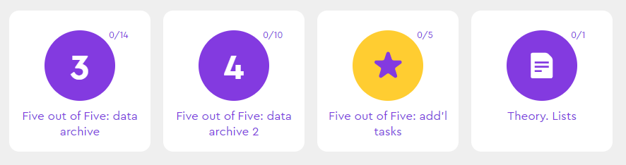
Additional tasks to improve your performance
A’s for All: Add’l tasks
Summing up
the work day

Slide 66
Share projects with other students
Hall of Fame

Slide 67
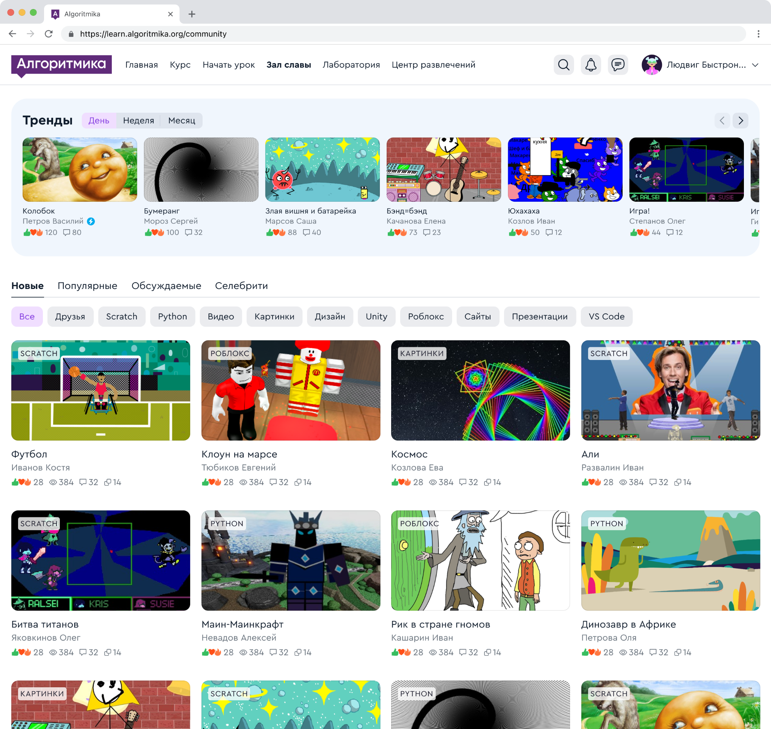
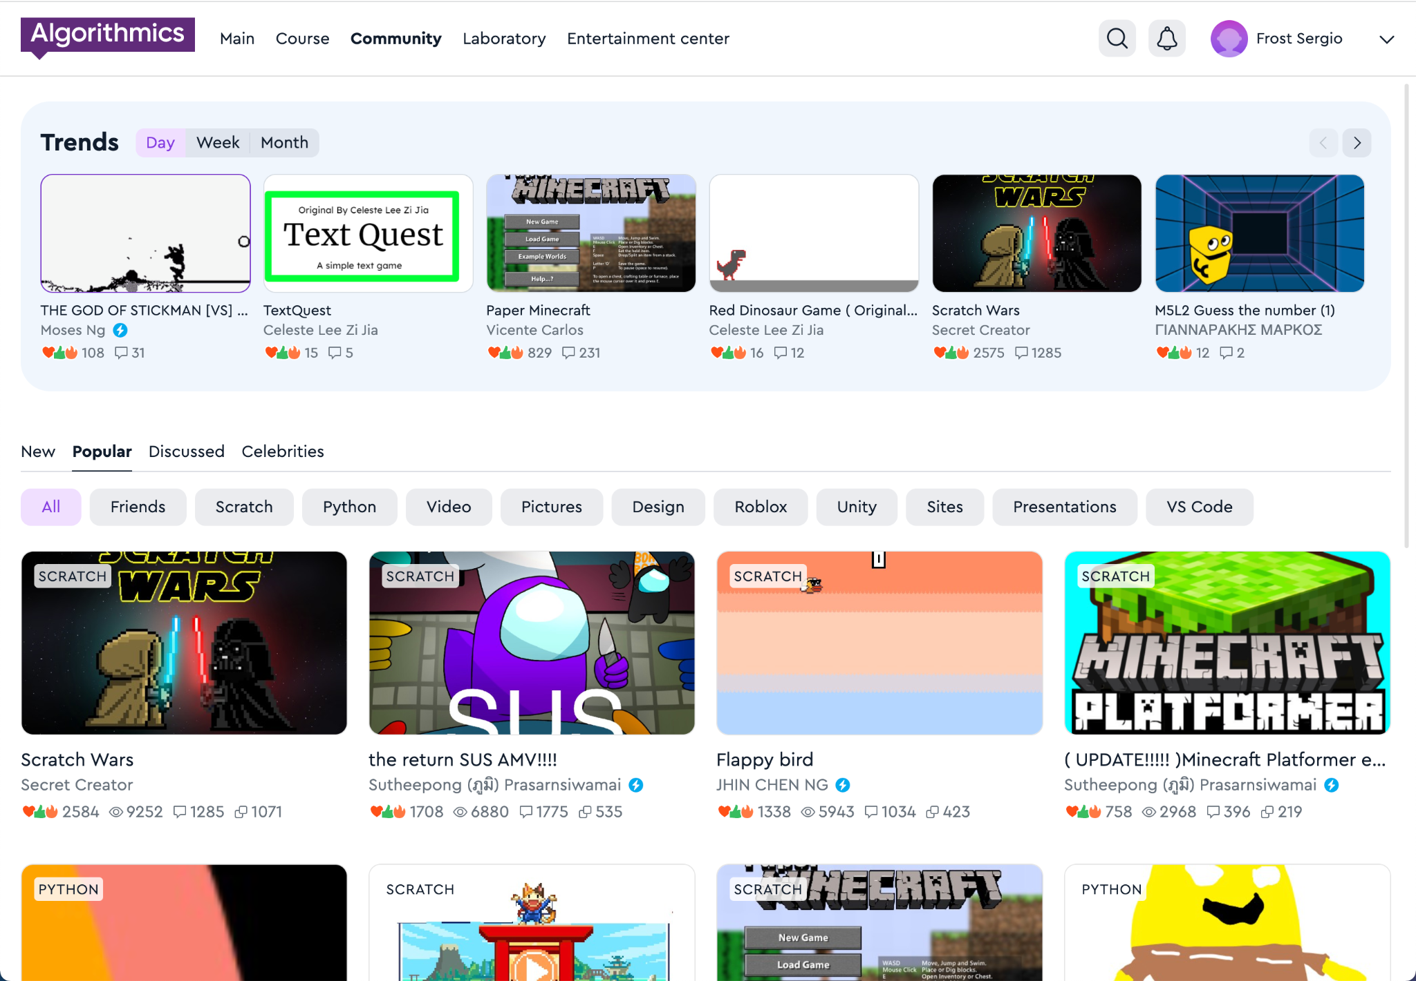
Hall of Fame
A space where our guys share projects, games, and ideas with each other.
In the Hall of Fame, the guys communicate and compete with each other
Hall of Fame

Slide 68
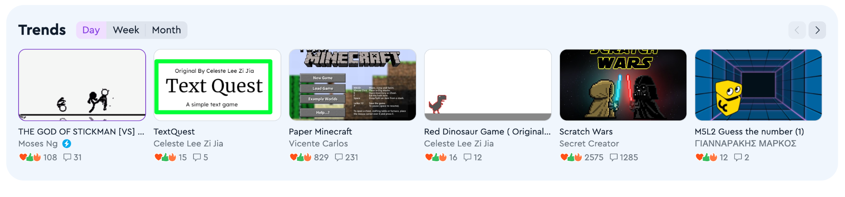
Trends
A block with new projects that are gaining popularity. The projects in this block help to understand what is happening in the Hall of Fame.
The trends reflect the projects that have the most likes and comments per day, week or month.
Hall of Fame

Slide 69
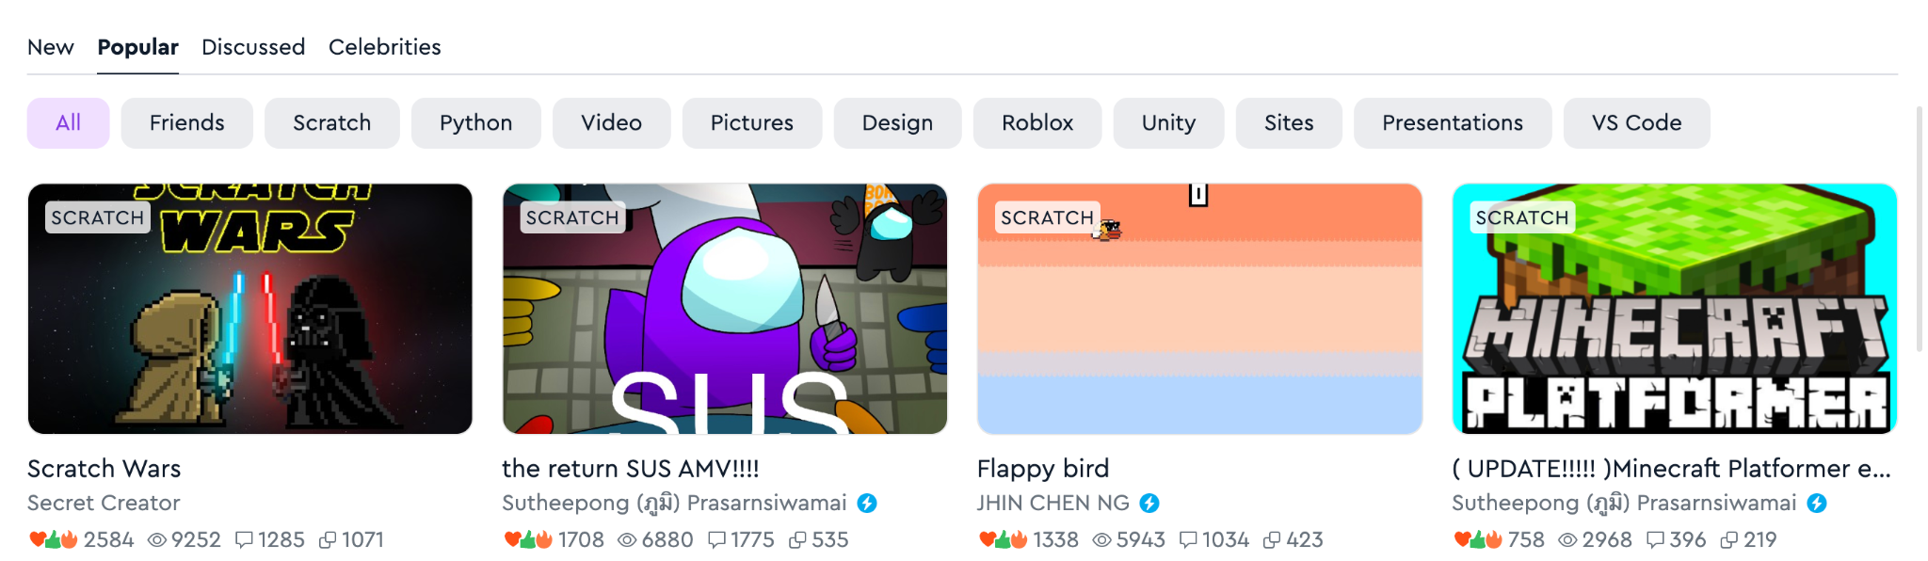
Viewing projects
Projects are displayed by newness, popularity and number of comments, and you can also view projects of "Celebrities", friends, and projects on individual subjects
Hall of Fame

Slide 70
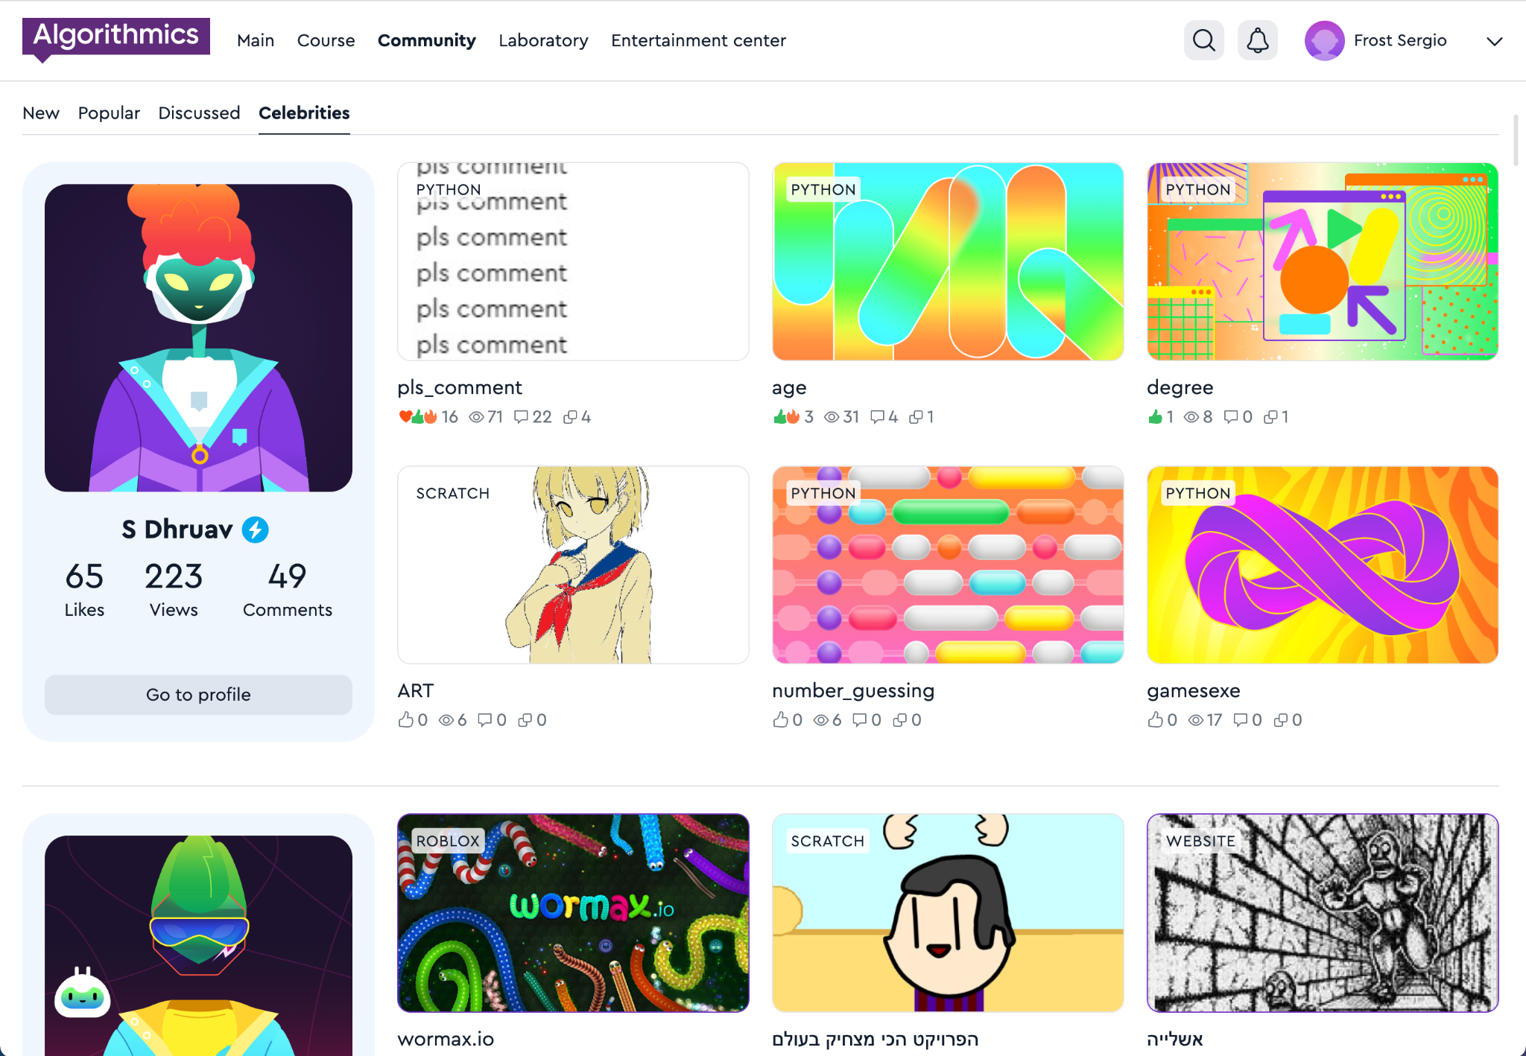

Celebrity
Students who make cool projects and win competitions receive a special status: "Celebrity".
A student who has received celebrity status receives a blue badge
Hall of Fame

Slide 71
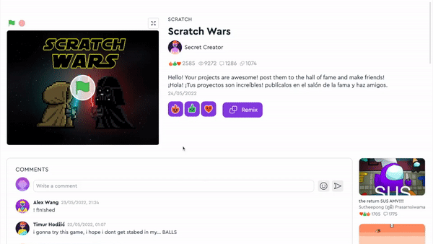
Projects
See the work of other students, play games.
Put reactions, share comments and discuss projects.
Hall of Fame

Slide 72
Hall of Fame rules
When you publish projects or write comments, make sure that you don't break the rules:
😇 | Politeness Do not scold or insult other students.
🤗 | Honesty Do not publish false information about events or people.
🕊 | Peace and friendship Don't add scenes of violence or crimes to your projects.
🚫 | No prohibited materials Do not publish indecent pictures, videos, text, etc.
For violating the rules, your access to the Hall of Fame will be restricted:
— for one week for the first violation,
— for two weeks for the second violation,
— for one month for the third and next violations, and we will also write to parents
Hall of Fame

Slide 73
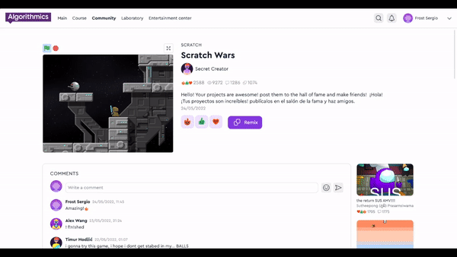

Full-screen project
It's easier to interact with projects if they are open in full screen mode.
To open the project, click on the arrow icon
Hall of Fame

Slide 74
Messages from the teacher and projects of classmates
My class

Slide 75
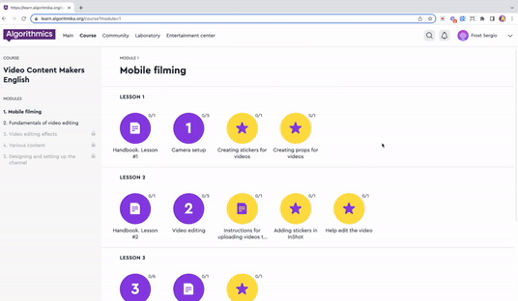
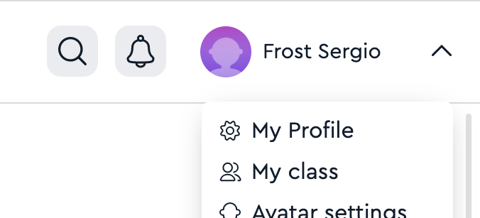
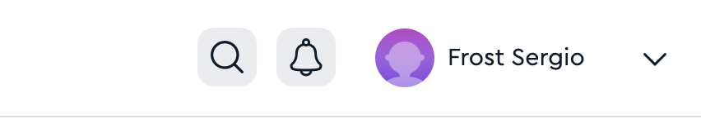
My class
The space in your classroom where you can publish and discuss projects with classmates, and view messages from the teacher.
1. Click on your name in the upper right corner
2. Click on the item
"My class"
Hall of Fame

Slide 76
Storing and viewing your projects
Laboratory

Slide 77



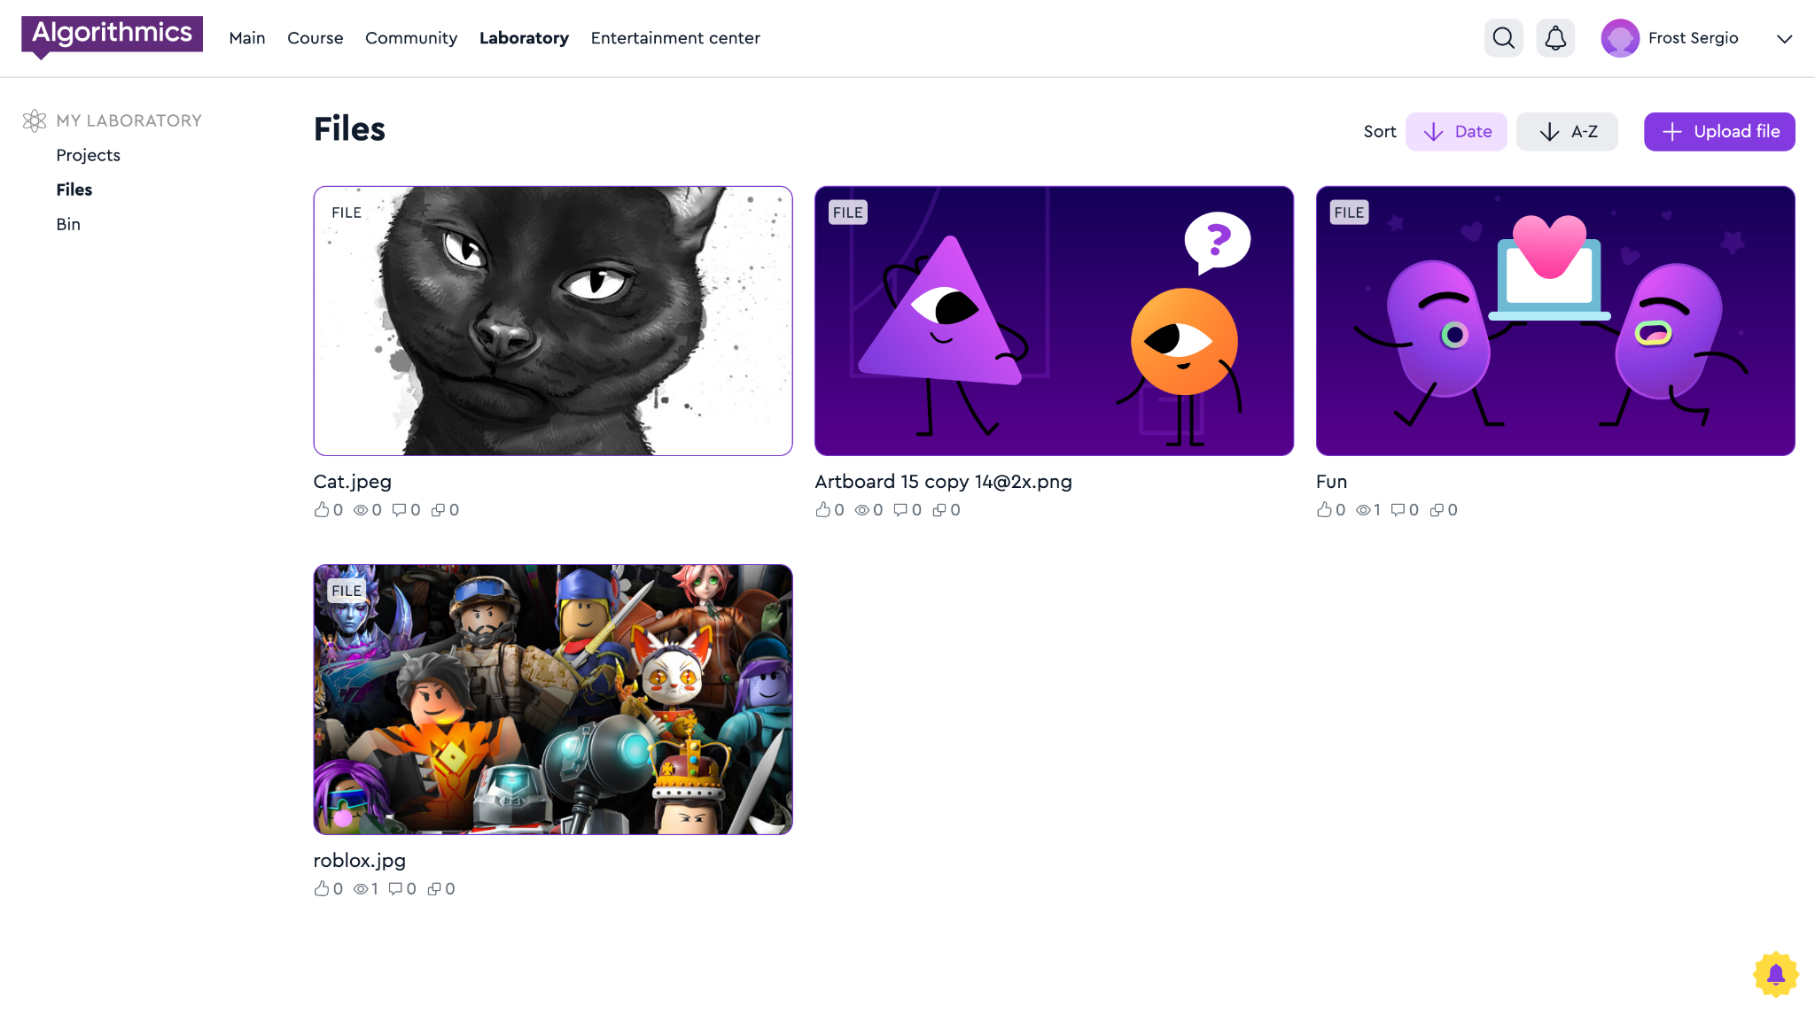
Your solutions are stored in the Lab
The files that you uploaded to the task on the platform go to the "Lab" on the "Files" tab.
Hall of Fame

Slide 78
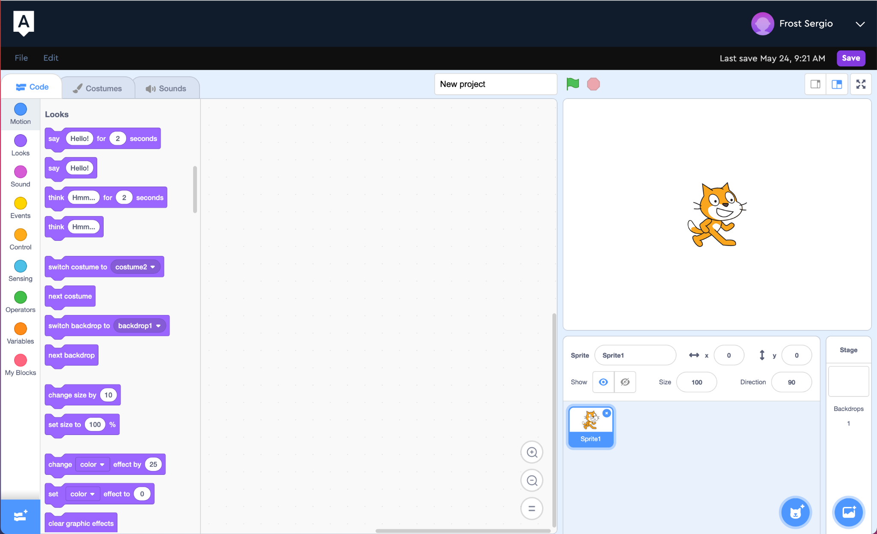
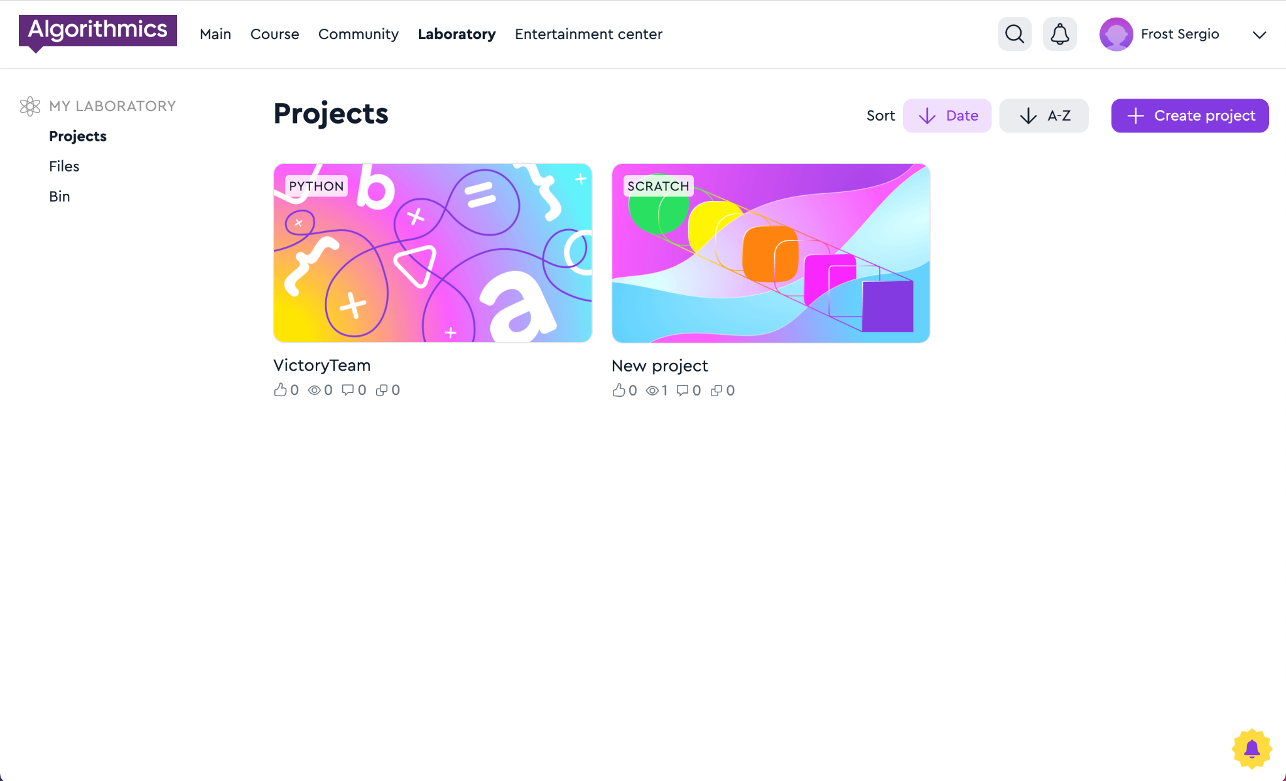
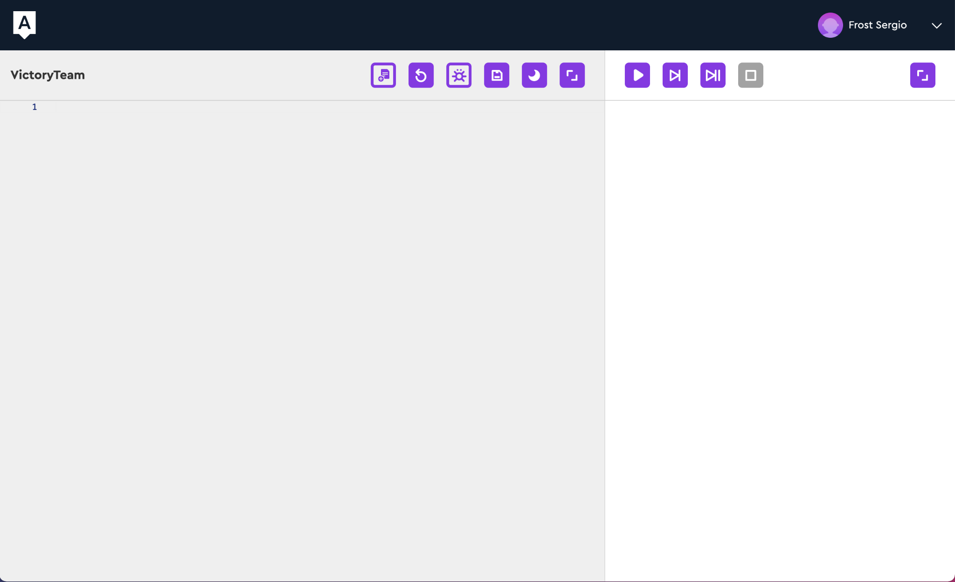
Your solutions are stored in the Lab
Scratch and Python solutions go to the "Lab" on the "Projects" tab immediately after saving.
Hall of Fame

Slide 79
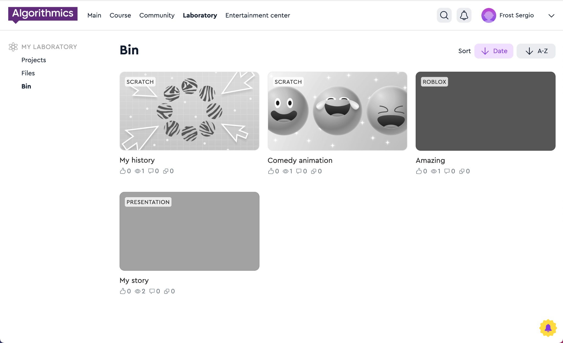
Deleted projects end up in the "Trash"
Hall of Fame

Slide 80
Publishing Python projects
Laboratory

Slide 81
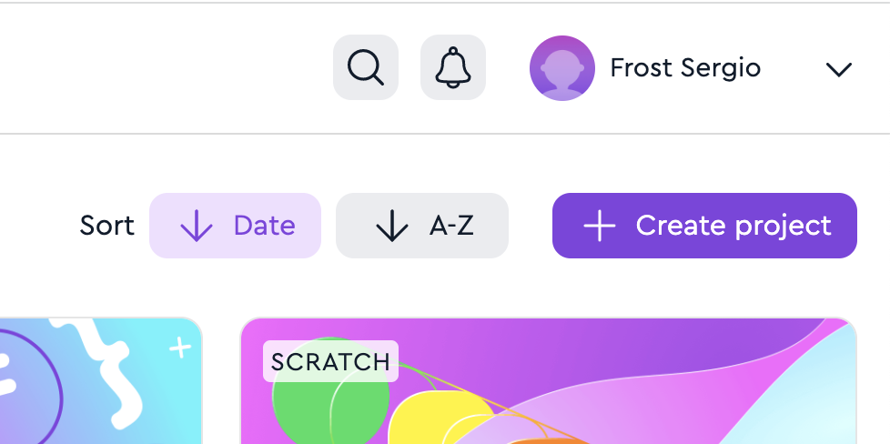
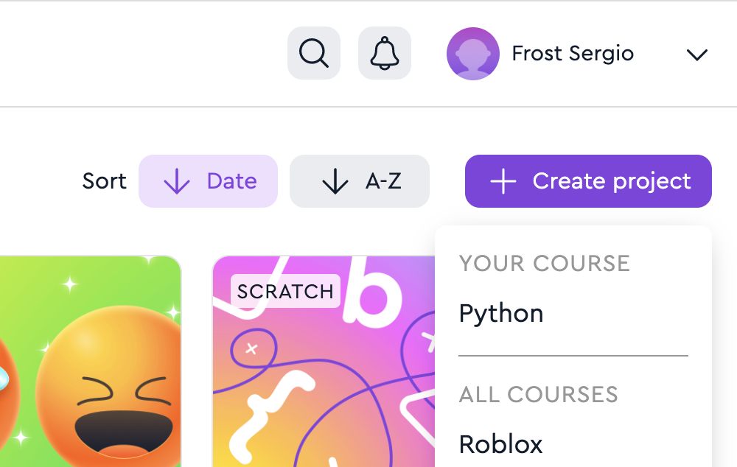
Create a project in the Lab
1. Go to the "Laboratory" page
2. Click on the button "+ Create project" → Python
Laboratory

Slide 82
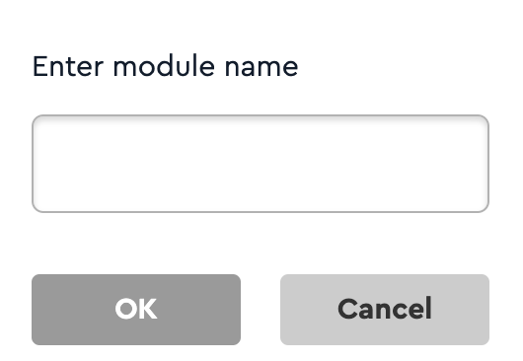
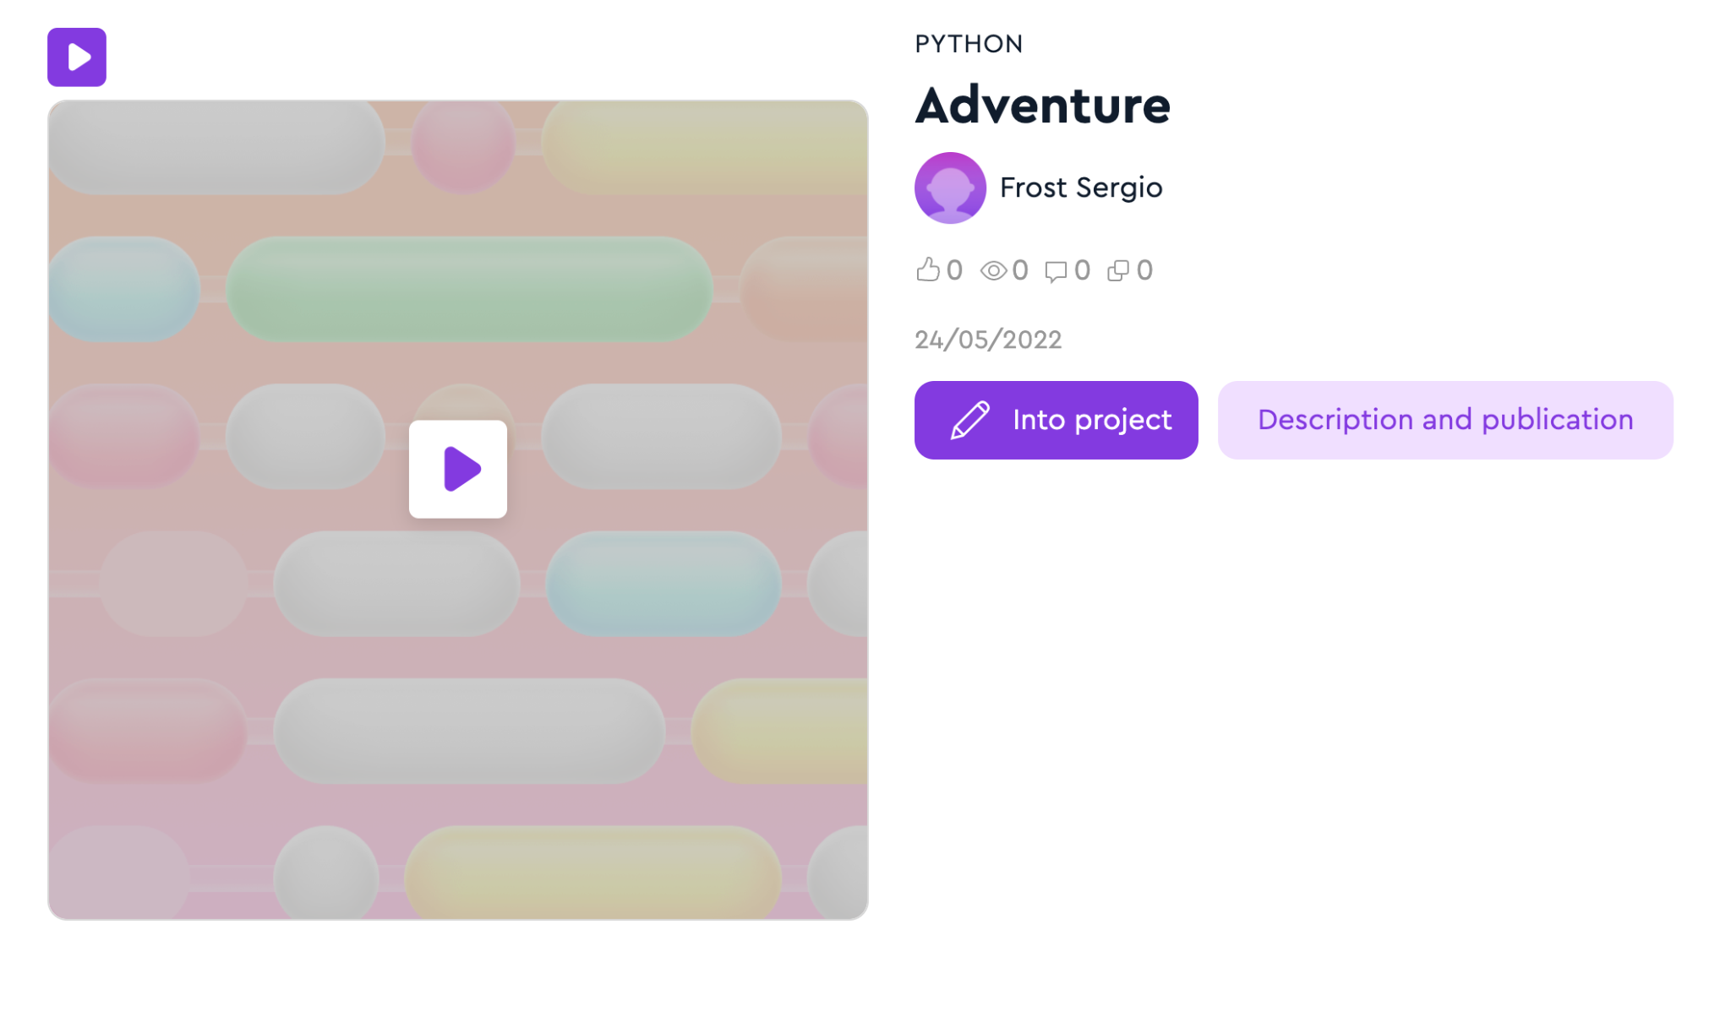
Add a name
3. Enter the project name Use only Latin letters, numbers and the sign "_" The name should not be the same as other names of projects on Python
4. Click "Description and publication"
Laboratory

Slide 83
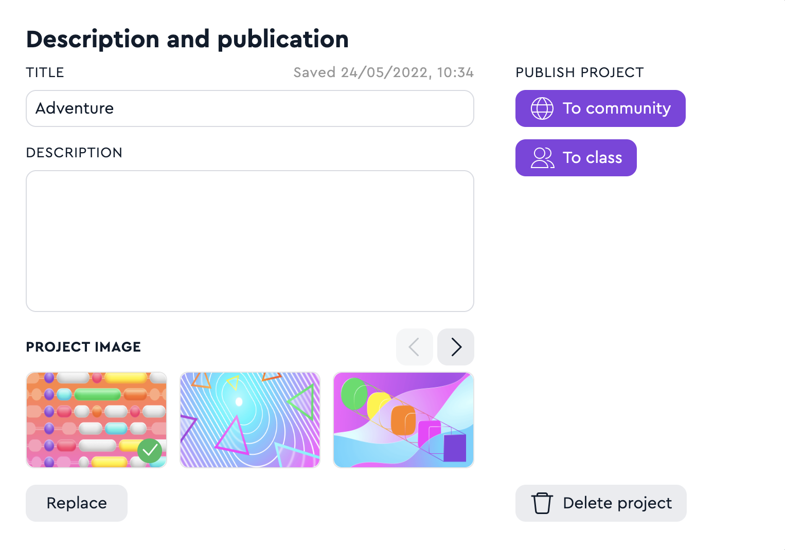
Enter a description and publish
5. Enter the name and description
6. Select and upload an image
7. Publish your project to the Hall of Fame or Class
Laboratory

